Slide 1
FLIGHT PRICE PREDICTION PROJECT
Submitted By: Niteen Kumar

Slide 2
Problem statement
The airline industry is considered as one of the most sophisticated industry in using complex pricing strategies. Nowadays, ticket prices can vary dynamically and significantly for the same flight, even for nearby seats. The ticket price of a specific flight can change up to 7 times a day. Customers are seeking to get the lowest price for their ticket, while airline companies are trying to keep their overall revenue as high as possible and maximize their profit. However, mismatches between available seats and passenger demand usually leads to either the customer paying more or the airlines company loosing revenue. Airlines companies are generally equipped with advanced tools and capabilities that enable them to control the pricing process. However, customers are also becoming more strategic with the development of various online tools to compare prices across various airline companies. In addition, competition between airlines makes the task of determining optimal pricing is hard for everyone.

Slide 3
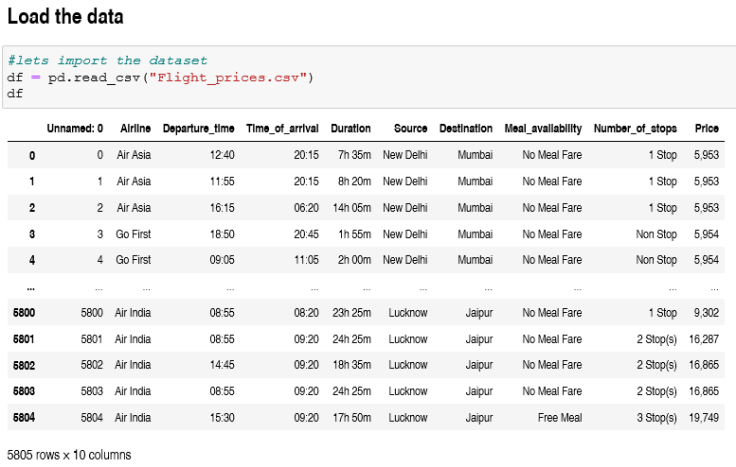
Analytical Problem Framing
For the given flight price prediction project I have scraped the flight prices along with some other features from a well known website that is ‘yatra.com’. And this data is framed into a data frame and saved into a .csv file. After that I have fetched this data set and performed some data processing and some EDA. The data set is having around 5805 rows and 10 columns.

Slide 4
Data Processing
Here the data types of all the features is given as object type. We need to convert it to correct respective data type of it. For that purpose we need to go through some data processing steps.
Duration column: This column is having string entries in hours and minutes; I have separated hours and minutes into two different columns by splitting and then by using both of these columns filled the entries into Duration column as given in above figure.
Departure_time & Time_of_arrival:
As similar to the case of duration column these two columns are also having the time but in a string format. And by using above code steps I have fetched numerical values for the time and filled to respective columns. And the extra columns from these three cases have deleted from the data set.

Slide 5
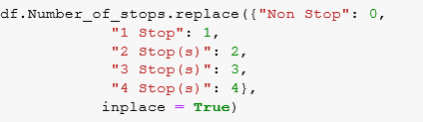
Number_of_stops:
This column is a categorical column and filled with string values, but we need to fill the values in ordinal manner so I have replaced the entries with corresponding numeric values.

Slide 6
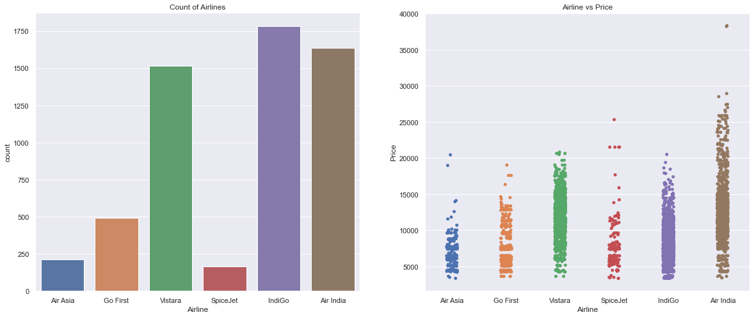
Exploratory Data Analysis
Above figure is showing two different plots one is count plot for the column Airline and another is a strip plot showing relation between Airline and Prices. The count plot will tell us that there are more numbers of flights of Vistara, IndiGo and Air India than others. Flights of Spice Jet are very less in numbers. Strip plot will tell us that Air India is having flights with higher prices.

Slide 7
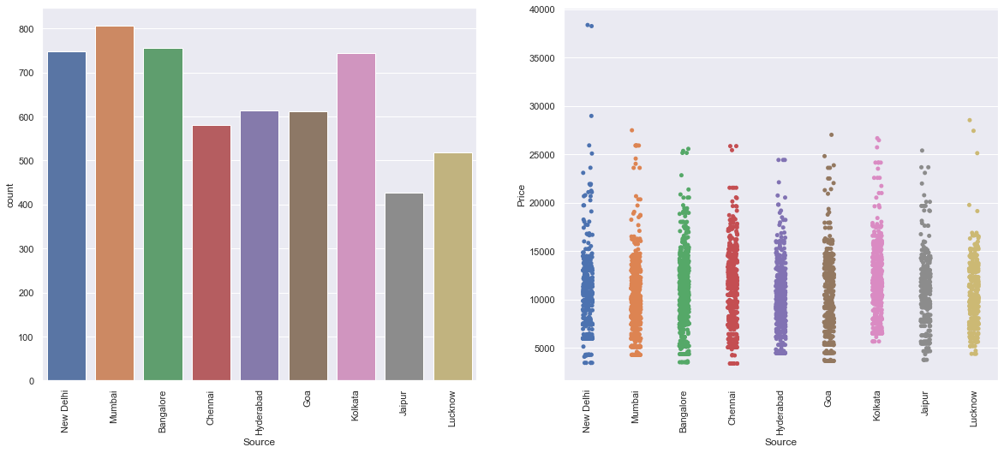
Source
Here we are having more number of flights from New Delhi, Mumbai, Bangalore and Kolkata than other cities. Looking at the strip plot we can say flights from New Delhi are having somewhat higher prices than other cities.

Slide 8
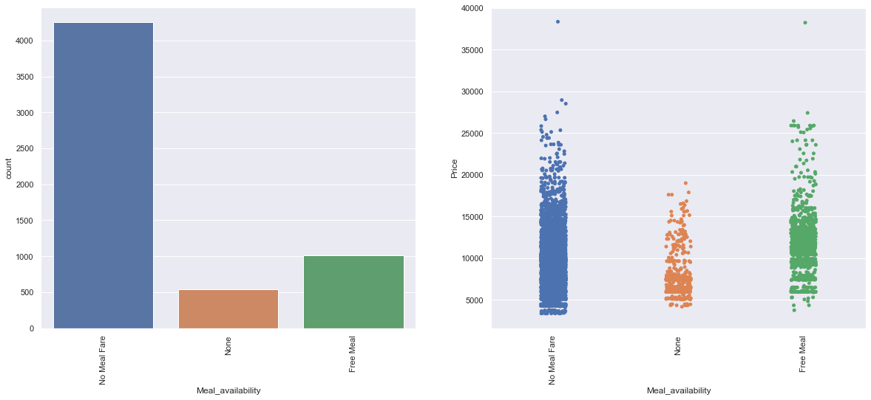
Meal_availability
Looking at above plots we can conclude that more number of flights are not including Meal Fare, some of with providing free meal and rest few are with None category.

Slide 9
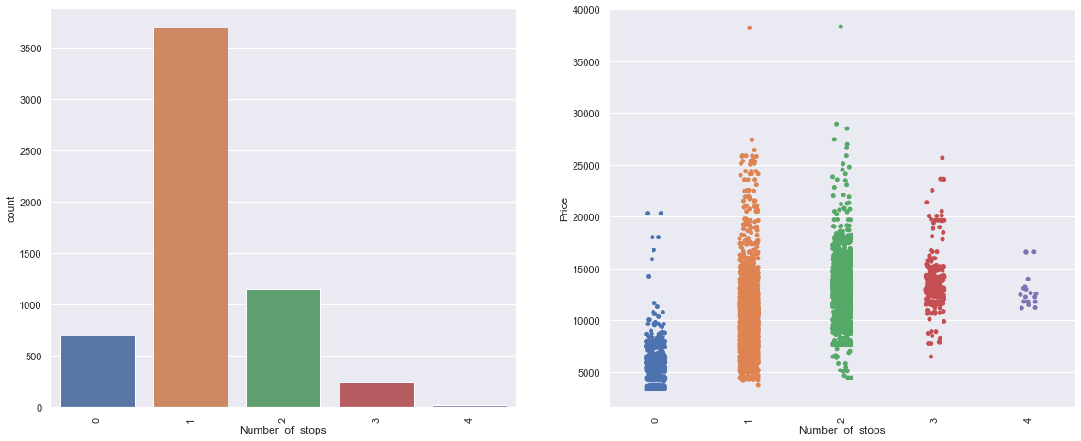
Number_of_stops
The above count plot will tell us that most of the flights are with 1 stop and very few are with 3 and 4 stops during the Journey. We can see that the prices are increasing with the number of stops.

Slide 10
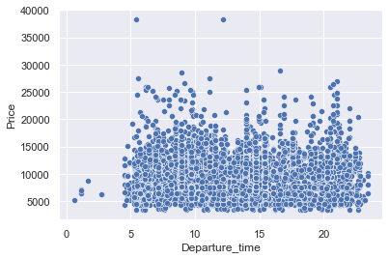
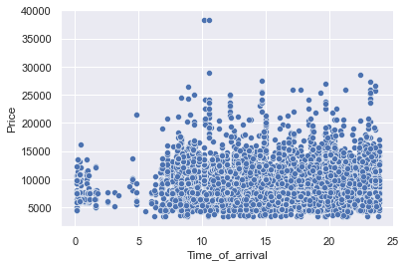
The first scatter plot is showing relationship between Departure time and flight prices. We can observe that there are very few flights departing in the early morning which are having lower price as well.
Second scatter plot is showing relation between Time of arrival and flight prices, which will tell us that very few numbers of flights are arriving in the early morning that is around 0 to 5 am. We can say the flight prices are not much dependent on the time of arrival.

Slide 11
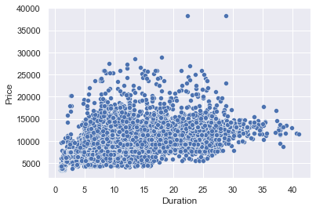
Duration vs Price
The above figure is representing the scatter plot of Duration vs Price. Looking at this figure we can say that there is some linear relation between price and duration. The prices increase with duration.

Slide 12
Model Building and Evaluation
Data Pre-processing
Outlier removing(using z_score method)
Skewness treatment
Normalizing the data(applying StandardScaler to numerical features)
Encoding categorical features(Using OrdinalEncoder)
For this project I have applied StandardScaler to numerical features for bringing it to a common scale and used ordinal encoder for categorical features. After doing such pre-processing steps I used this data for model building with the help of train_test_split. I have defined a function to train and evaluate our algorithms. For this task I have used many regression algorithms and selected LGBMRegressor as it is giving better performance than other algorithms. Linear models were giving least difference in r2-score and cv-score but in this case the r2-score was very less compared to tree based algorithms. Other than LGBMRegressor algorithms showing the problem of over-fitting so I selected LGBMRegressor which is not over-fitting much compared to others.

Slide 13
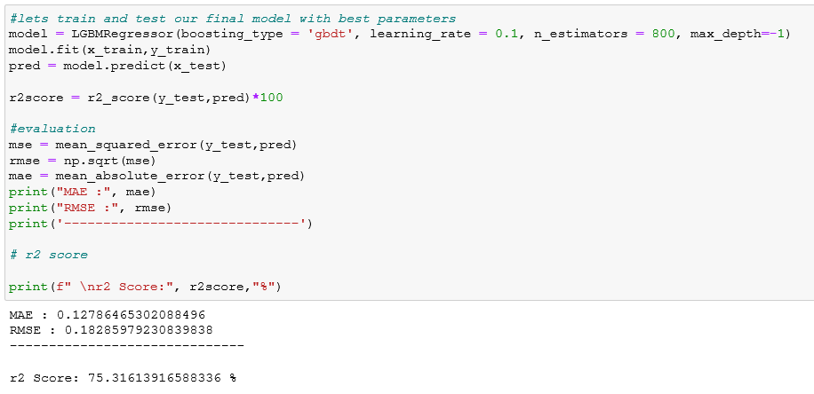
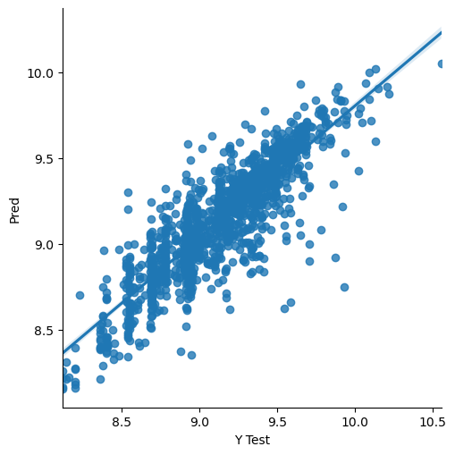
Final Model
Great we have achieved a better r2 score after doing hyperparameter tuning than earlier.

Slide 14
Conclusion
Key findings of the study
In this project we have scraped the flight data from yatra.com. Then the .csv file is loaded into a data frame.
Luckily we don't have any missing values in our data set.
Looking at the data set we understand that there are some features needs to be processed like converting the data types, and get the actual value from the string entries from the time related columns.
After the data is been processed I have done some EDA to understand the relation among features and the target variable.
Features like flight duration, number of stops during the journey and the availability of meals are playing major role in predicting the prices of the flights
Limitations of this work and scope for the future work
As looking at the features we came to know that the numbers of features are very less, due to which we are getting somewhat lower r2-scores.
Some algorithms are facing over-fitting problem which may be because of less number of features in our dataset.
We can get a better r2 score than now by fetching some more features from the web scraping by that we may also reduce the over fitting problem in our models.

Slide 15
Thank You

